Slide 1
Software engineering final presentation
ZHENGRUI XIA
HAOCHEN LI

Slide 2
Contents
Introduction: Overall introduction to our project and Unity® engine;
Overall Project Structure;
Game Logic: Use cases & classes;
Network Synchronization: Lua-based network connection & lockstep;

Slide 3
PART I: Introduction

Slide 4
INTRODUCTION TO THIS PROJECT
This project is a Real-Time Strategy (RTS) tower defense game. At most 8 players are free to choose between 2 sides. Each player can control a hero and several spawns. Once a side’s base is destroyed, the other side wins.
This project is based on the Unity game engine. Unity engine provides built-in support for global illumination, mapping, physics engine, and event handling.
Unity has an online asset store where one can purchase and download game object models.
Game scripts in Unity are based on Mono, which provides a set of available event handling mechanism. We use C# classes to realize game scripts, and each class inherits class MonoBehaviour.

Slide 5
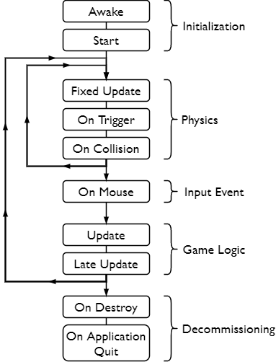
C# IN UNITY: Mono BEHAVIORS
In-game scripts are attached to game objects. During the life cycle of a game object, Mono provides several behaviors to trigger script codes.
All Mono behaviors involved in our project is shown on the right.

Slide 6
PART II: OVERALL PROJECT STRUCTURE

Slide 7
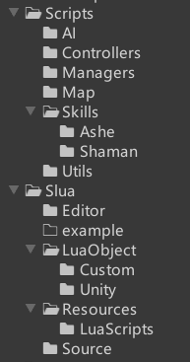
overall project code structure
Project codes are only part of the entire project, but is also its core!
Scripts contains all the scripts supporting game logic.
Slua contains all the scripts supporting network communication.
Notes:
在这里开始转到对detail的讲解！

Slide 8
PART III: GAME LOGIC

Slide 9
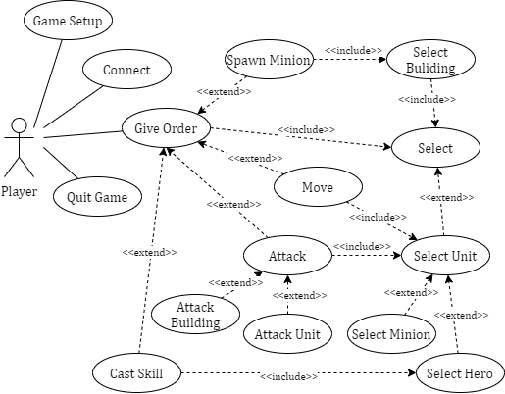
GAME LOGIC – USE CASES

Slide 10
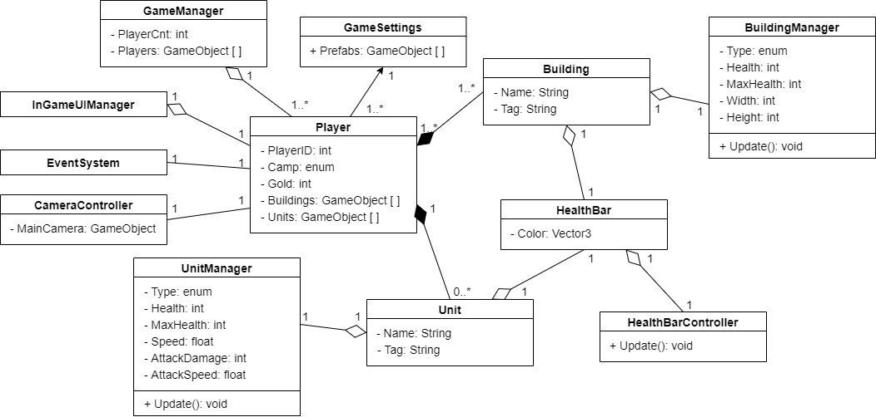
GAME LOGIC -- CLASSES

Slide 11
PART IV: Network Synchronization

Slide 12
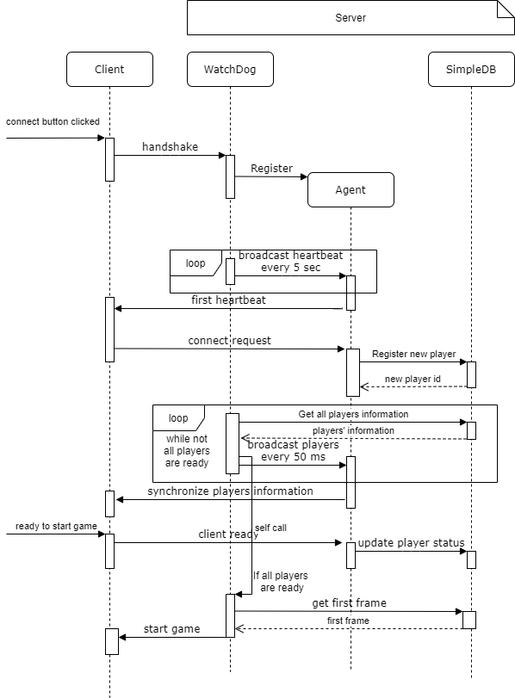
NETWORK SYNCHRONIZATION -- CONNECTION
This sequence diagram illustrates the synchronization at the game lob stage (players log-in stage).
We use the Skynet (a lightweight online game framework that supports multi-process server cluster).
We use Sproto to design our network protocols.
Client side we use Slua (the fastest lua-binding unity plugin) to handle the network component.

Slide 13
NETWORK SYNCHRONIZATION -- LockStep
Execute F3
Execute F4
Execute F5
Execute F6
Execute F7
Execute F2
2n frame
(50ms/frame)
3rd frame
4th frame
5th frame
6th frame
7th frame
A client send a command to the server (When a player clicked to give an order).
Network delay
Client 1
A client requests the next frame from the server.
Get
2nd
frame
Get
3rd
frame
Get
4th
frame
The server send back the requested frame.
Send a
command
Server
2nd frame
3rd frame
4th frame
time
5th frame
6th frame
7th frame
8th frame
Get
2nd
frame
Get
3rd
frame
Send a
command
Get
4th
frame
Client 2
Send a
command
Network delay
2n frame
(50ms/frame)
3rd frame
4th frame
5th frame
6th frame
7th frame
Key Frame: 50 ms (20 fps)
Logic Frame: 10 ms (100 fps)
Render Frame: depends on your hardware.
Nodata, lock
Execute F2
Execute F3
Nodata, lock
Nodata, lock
Nodata, lock
Execute F7
lagging
Execute F4
Execute F5
Execute F6

Slide 14
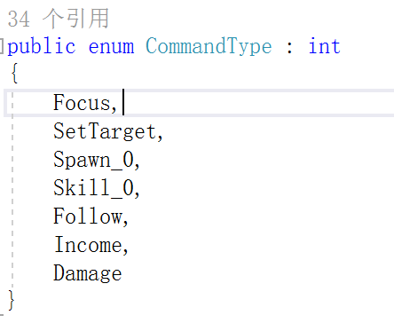
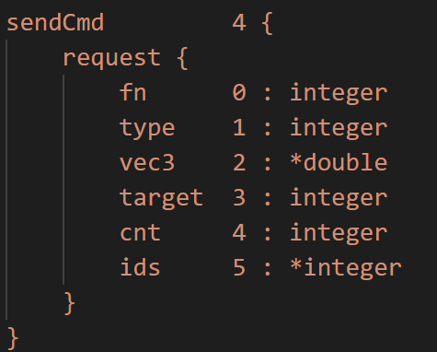
NETWORK SYNCHRONIZATION -- LockStep
Why LockStep when unity has an easy-to-use State Sync framework?
Small bandwidth requirement.
Easy to be implemented.
Transportability.
Some problems of LockStep:
We have to make sure that all machines conduct the same results after executing the same command.
Unity's physics system, update time interval, and navigation components are not deterministic. Therefore, we have to find a replacement.
Currently, we have disabled the collision, and use unity's FixedUpdate() and our customized update loop to update synchronized objects.
In the future, we have to implement or use a deterministic physics system and navigation system.

